Slide 1
Discovering and Investigating Propagated Vulnerabilities from Ethereum to Its Layer-2 Blockchains
Dr. Daoyuan Wu
Research Assistant Professor, HKUST
TRACK 1
30 AUG

Slide 2
Ethereum is the most popular blockchain for hosting smart contracts
Crowdfunded and Development begun in 2014.
The PoW (Proof-of-Work) network went live on 30 July 2015.
Switched to PoS (Proof-of-Stake) on 26 Feb 2023.
More than 2B (2,487,725,064 as of Aug 26) transactions sent.
More than 1M (1,344,143 as of Aug 26) token contracts created.
Ethereum’s smart contract language, Solidity, appears in Top Programming Languages 2024.
Notes:
https://spectrum.ieee.org/top-programming-languages-2024

Slide 3
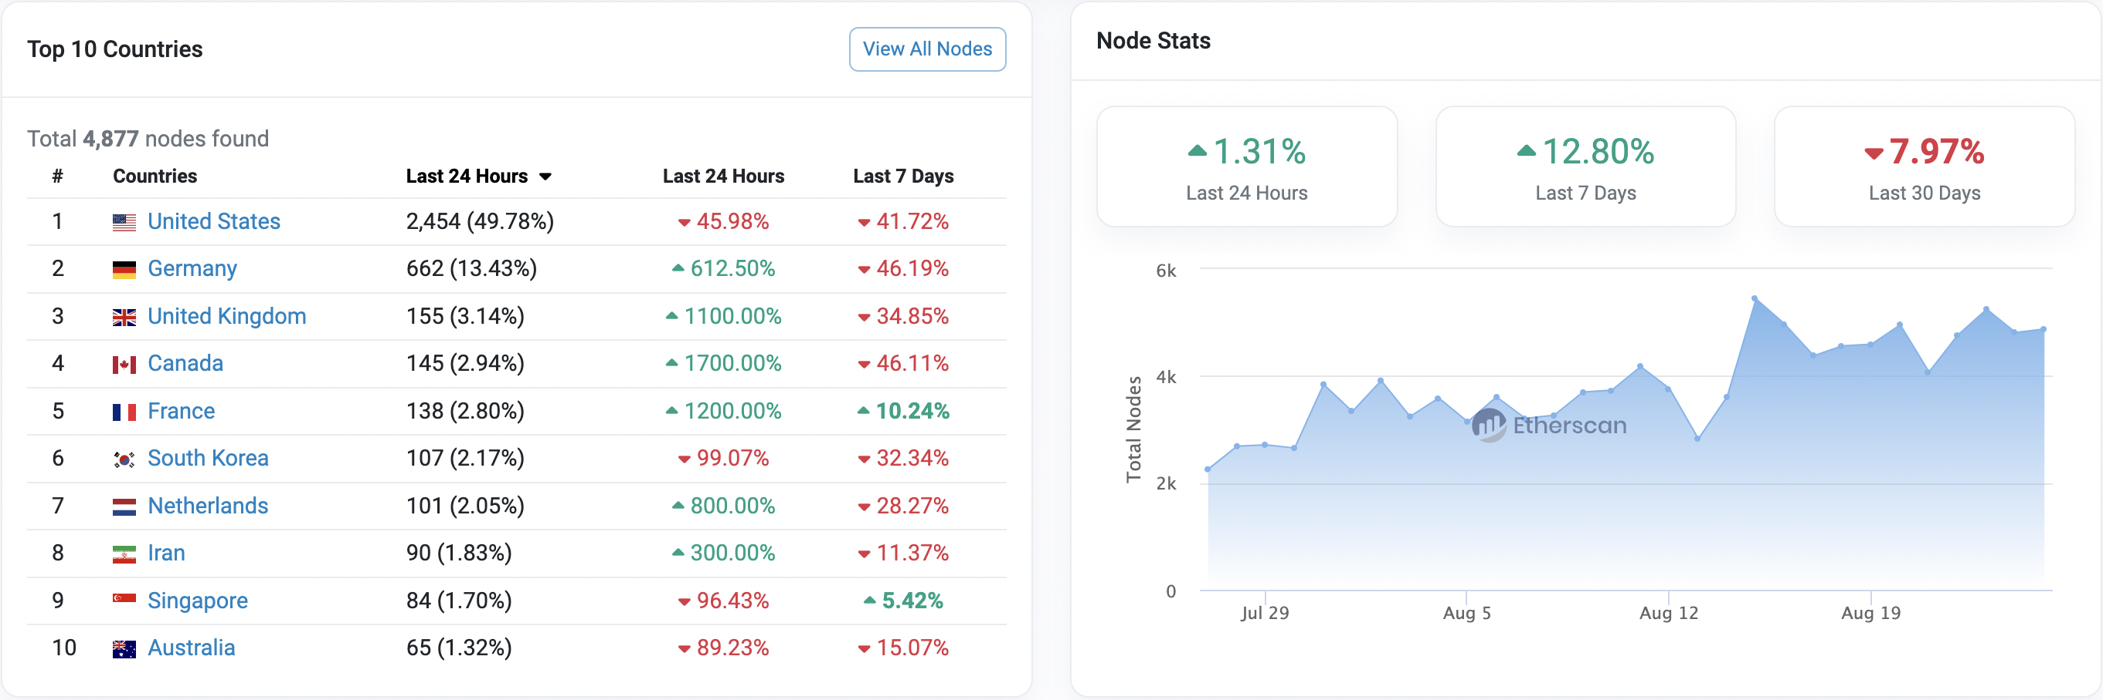
Ethereum is also quite decentralized

Slide 4
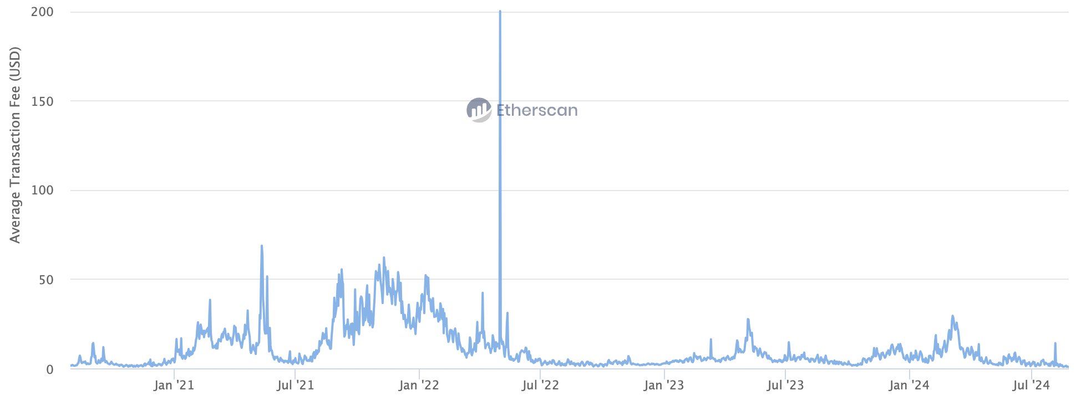
Ethereum suffers from low throughput and expensive transaction fees
Ethereum currently has only 14.3 TPS (transactions per second).
The transaction fee is now around 1USD in the bear market but was high in the past.

Slide 5
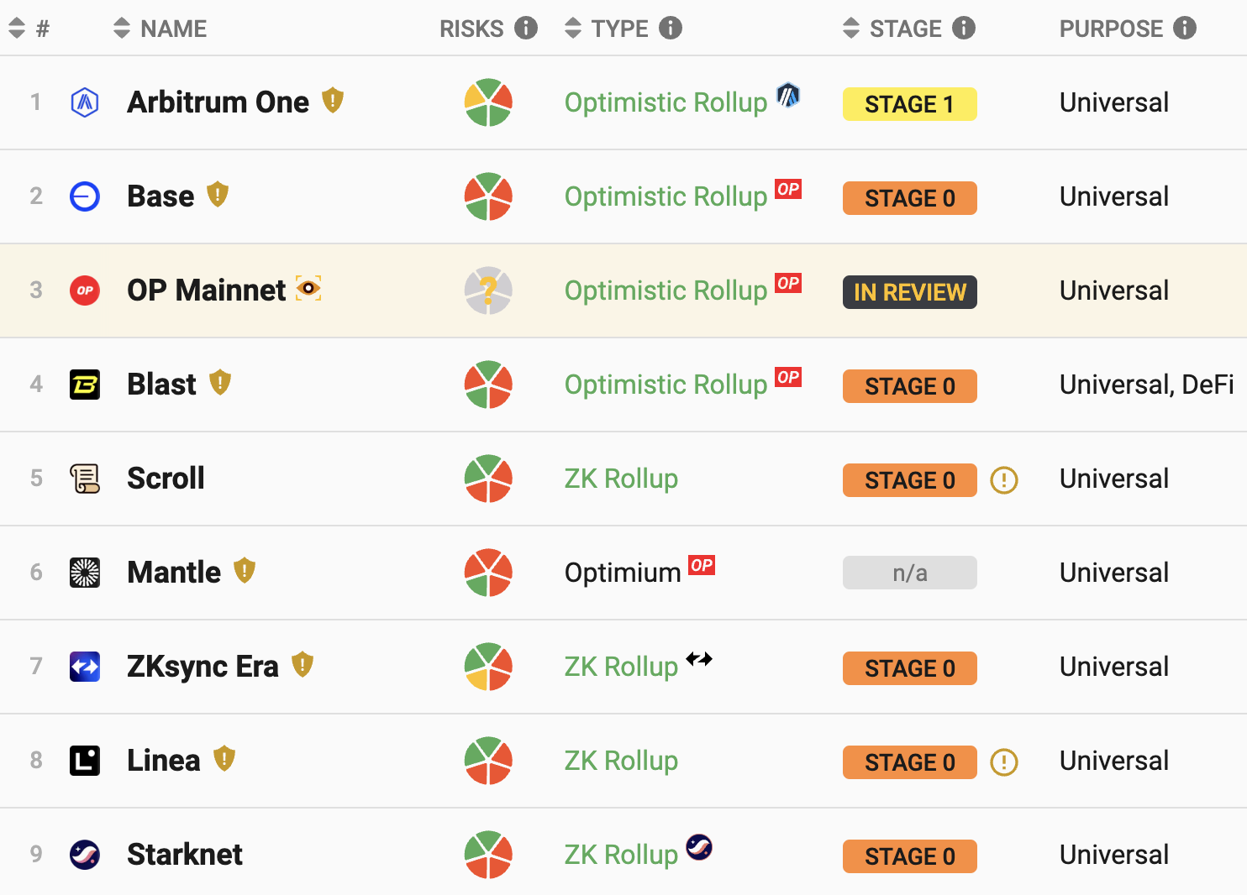
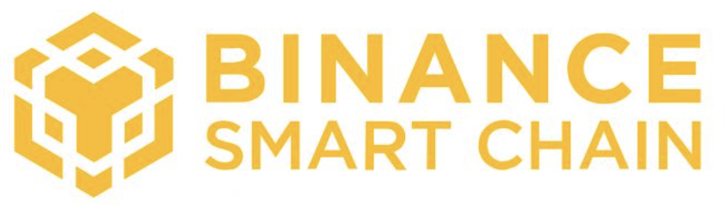
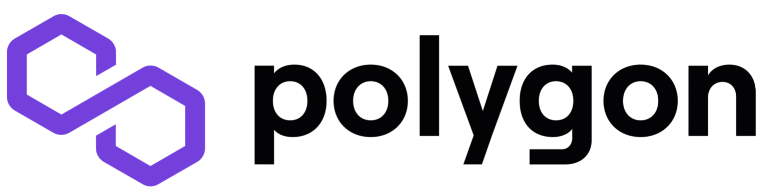
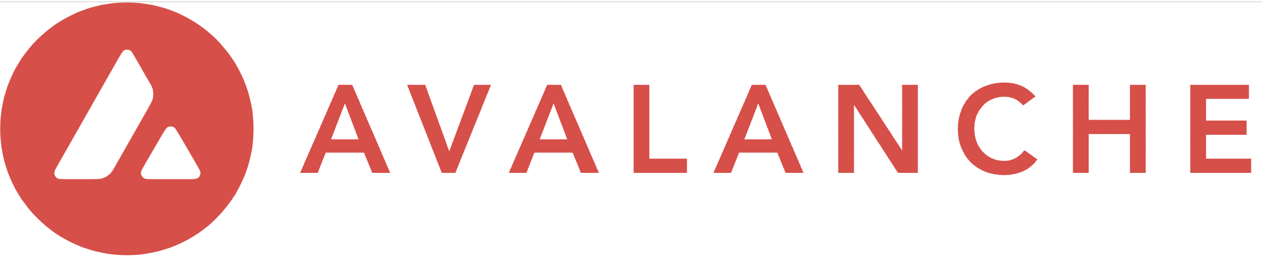

Third-party layer-2 blockchain networks have emerged in recent years
Notes:
https://l2beat.com/scaling/summary

Slide 6
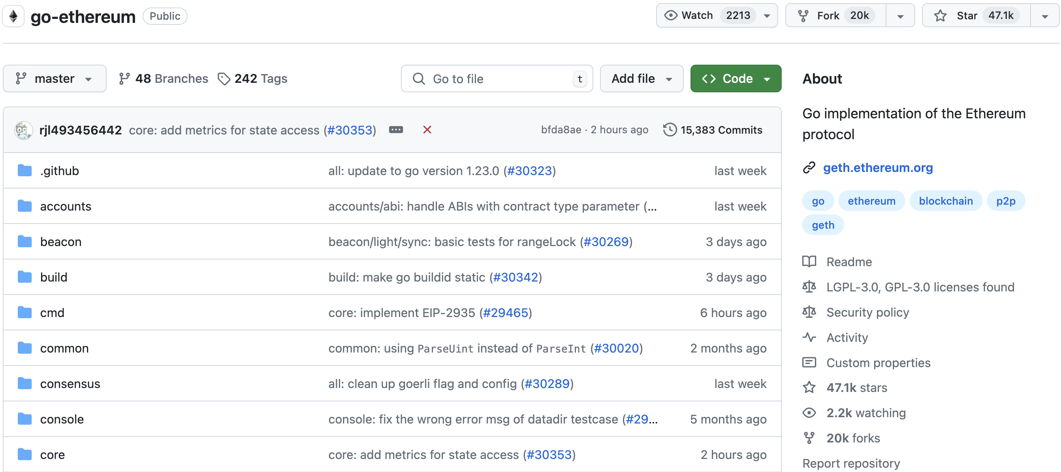
They copy & customize Ethereum

Slide 7
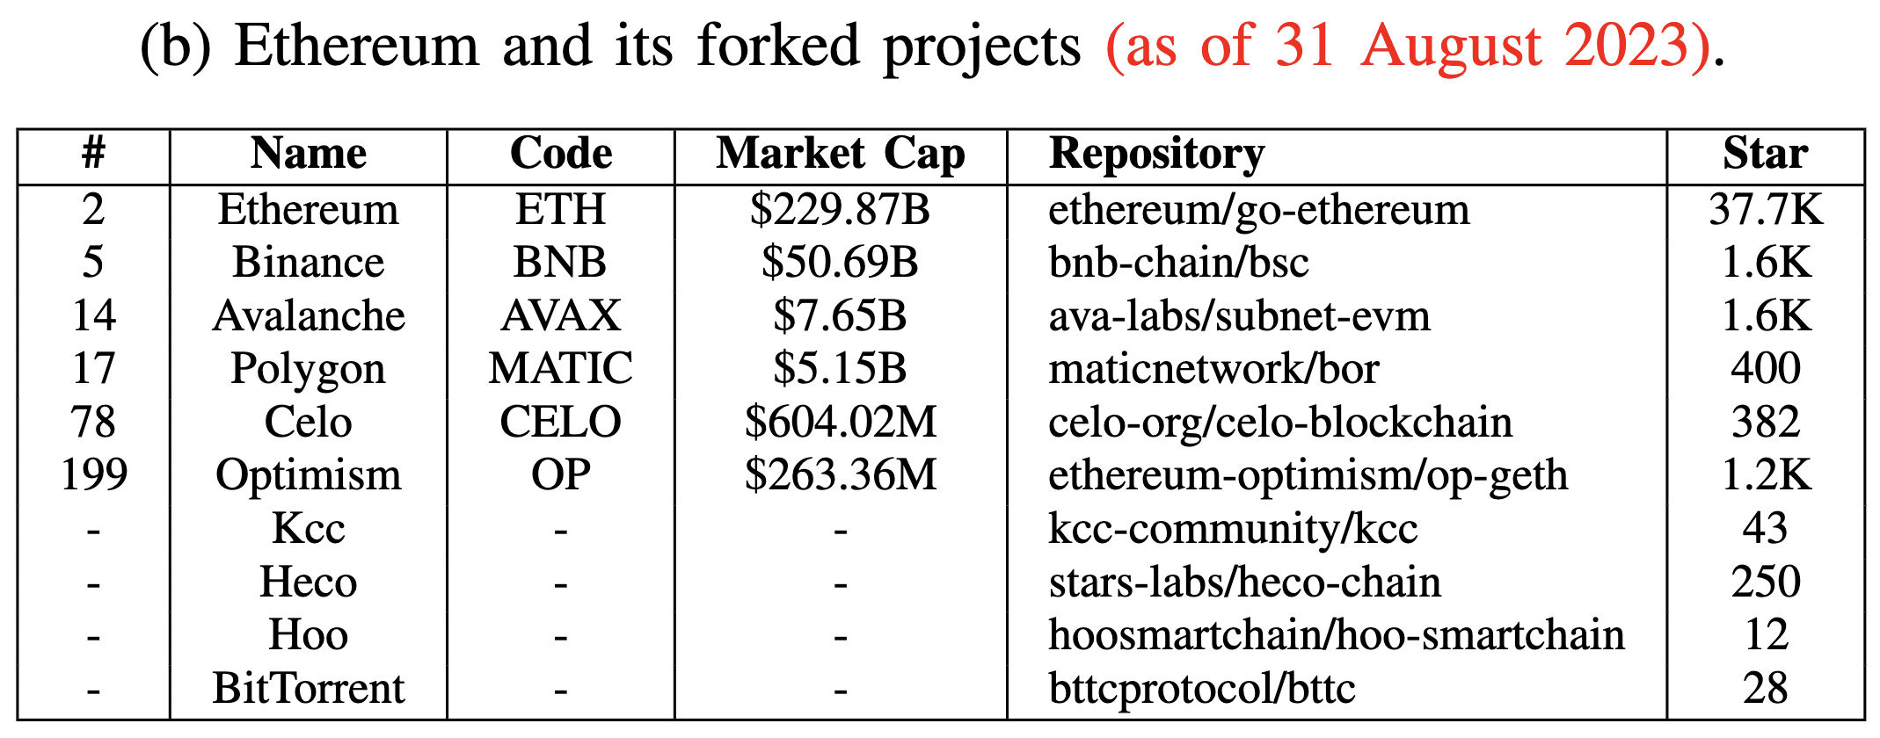
They copy & customize Ethereum

Slide 8
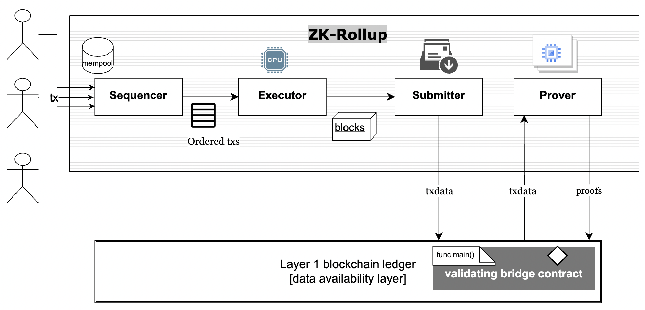
The architecture between Ethereum and its layer-2 blockchain networks
EVM
Ethereum
Source: arXiv:2310.03616

Slide 9
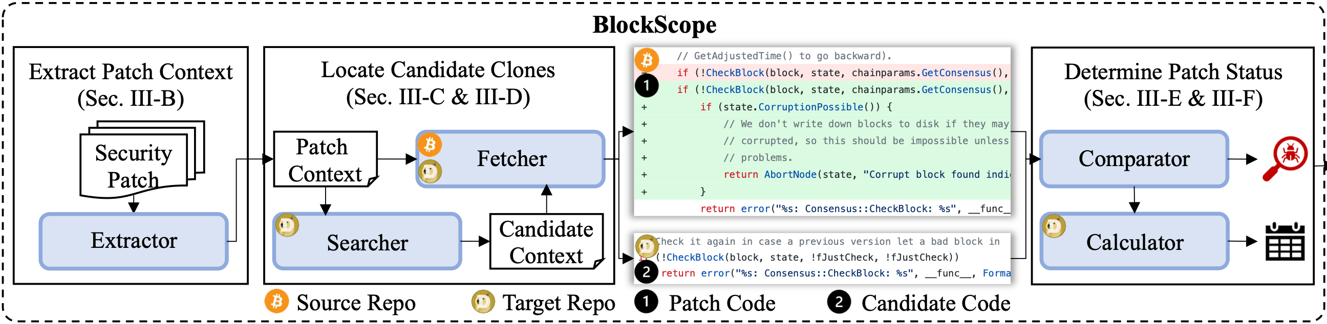
Our Tool: BlockScope
A novel patch-based clone detection tool for propagated vulnerabilities in forked blockchain projects.
1. Leverage patch code contexts to locate only potentially relevant code
2. Adopt similarity-based code match for being immune to clone variants
Notes:
To answer these questions, we propose BlockScope, a novel patch-based clone detection tool for vulnerable code clones in forked projects.
Specifically, BlockScope first extract the context from a security patch, and use the context information to locate possible vulnerable code clones in the target repository.
By comparing the similarity between the patch code and candidate code, BlockScope can determine whether the target repository has applied patch.
BlockScope has two unique designs. First, it ; Second, it adopts …

Slide 10



Context-based Candidate Clone Search
UP context
Source patch code hunk from Bitcoin
Target candidate code hunk from Dogecoin
start statement (ss)
1 |  | AssertLockHeld(cs_main);
2 |  | assert(pindex);
3 |  | assert((pindex->phashBlock == nullptr) ||
4 |  | (*pindex->phashBlock == block.GetHash()));
5 |  | int64_t nTimeStart = GetTimeMicros();
6 | - | if (!CheckBlock(block, state, chainparams.GetConsensus(), !fJustCheck, !fJustCheck))
7 | + | if (!CheckBlock(block, state, chainparams.GetConsensus(), !fJustCheck, !fJustCheck)) {
8 | + | if (state.CorruptionPossible()) {
9 | + | return AbortNode(state, “Corrupt block found ...");
10 |  | return error("%s: Consensus::CheckBlock: %s", __func__, ...);
11 |  | uint256 hashPrevBlock = pindex->pprev == nullptr ? uint256() : ...;
12 |  | assert(hashPrevBlock == view.GetBestBlock());
13 |  | if (block.GetHash() == chainparams.GetConsensus().hashGenesisBlock) {
14 |  | if (!fJustCheck)
1 | bool ConnectBlock(const CBlock& block, CValidationState& state, ...,
2 | CCoinsViewCache& view, const CChainParams& chainparams, bool fJustCheck)
3 | AssertLockHeld(cs_main);
4 | const Consensus::Params& consensus = Params().GetConsensus(pindex->nHeight);
5 | int64_t nTimeStart = GetTimeMicros();
6 | if (!CheckBlock(block, state, !fJustCheck, !fJustCheck))
7 | return error("%s: Consensus::CheckBlock: %s", __func__, ...);
8 | uint256 hashPrevBlock = pindex->pprev == NULL ? uint256() : ...;
9 | assert(hashPrevBlock == view.GetBestBlock());
10 | if (block.GetHash() == Params().GetConsensus(0).hashGenesisBlock) {
11 | if (!fJustCheck)
AssertLockHeld(cs_main);
assert((pindex->phashBlock == nullptr) ||
AssertLockHeld(cs_main);
(*pindex->phashBlock == block.GetHash()));
const Consensus::Params& consensus = Params().GetConsensus(pindex->nHeight);
end statement (es) & key statement (ks)
int64_t nTimeStart = GetTimeMicros();
int64_t nTimeStart = GetTimeMicros();
int64_t nTimeStart = GetTimeMicros();
Determine the boundary ss and es by similarity
if (!CheckBlock(block, state, !fJustCheck, !fJustCheck))
Leverage git grep to find ks in target repo
start statement (ss)
return error("%s: Consensus::CheckBlock: %s", __func__, ...);
return error("%s: Consensus::CheckBlock: %s", __func__, ...);
uint256 hashPrevBlock = pindex->pprev == nullptr ? uint256() : ...;
uint256 hashPrevBlock = pindex->pprev == NULL ? uint256() : ...;
assert(hashPrevBlock == view.GetBestBlock());
key statement (ks)
assert(hashPrevBlock == view.GetBestBlock());
assert(hashPrevBlock == view.GetBestBlock());
if (block.GetHash() == chainparams.GetConsensus().hashGenesisBlock) {
if (block.GetHash() == Params().GetConsensus(0).hashGenesisBlock) {
end statement (es)
if (!fJustCheck)
if (!fJustCheck)
DOWN context
Notes:
For the first challenge, we propose the context-based code search, that is to locate the possible clones by using the context information of a security patch.
We provide a code clone case here, where the left side shows a security patch from Bitcoin, while the right side is the cloned version in Dogecoin.
We can see that up context and down context of the two sides are almost identical, but Dogecoin keeps the unfixed version of the code. Thus, this is a case of vulnerable code clone.
Guided by this example, we need to first locate the possible clones in the target repository and then determine the patch status.
Therefore, we first extract the patch information by selecting tokens from each statement and leverage git grep to search for these key statements in the target repository.
Once identified the key statements, we check its nearby statements to find the boundary of the contexts.
Then we measure the similarity of the up/down contexts, if the similarity exceeds the threshold, we regard them as clones.
Finally, we can determine the patch status by comparing the statements between the up/down contexts’ boundary.

Slide 11


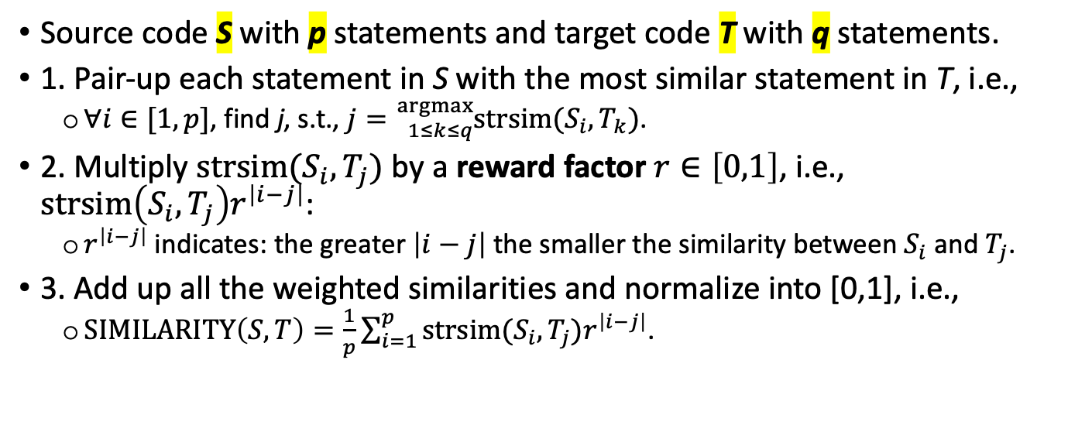
A New Way of Calculating Code Similarity
S p=5
T q=3
Source code S with p statements and target code T with q statements.
1. Pair-up each statement in S with the most similar statement in T, i.e.,
$∀i∈[1,p]$, find j, s.t., $j={}_{1≤k≤q}^{argmax}{strsim(S_{i},T_{k})}$.
2. Multiply $strsim(S_{i},T_{j})$ by a reward factor $r∈\left[0,1\right]$, i.e., $strsim\left(S_{i},T_{j}\right)r^{\left|i−j\right|}$:
$r^{\left|i−j\right|}$ indicates: the greater $\left|i−j\right|$ the smaller the similarity between $S_{i}$ and $T_{j}$.
3. Add up all the weighted similarities and normalize into [0,1], i.e.,
$SIMILARITY\left(S,T\right)=\frac{1}{p}\sum_{i=1}^{p}{strsim(S_{i},T_{j})r^{\left|i−j\right|}}$.
$p≠q$ $\text{issue}$
$$\text{code} \text{ordering} \text{issue}$$
Notes:
To determine whether two code fragments are clones, we propose a new way of calculating code similarity that should be immune to type 1/2/3 clones.
Given source code s with p statements and target code t with q statements, as we want to cover type 3 clones, which means p may not equals to q as shown the example.
Thus, we first pair up each statement in s with the most similar statement in t, for instance, line 1 on the left is paired with line 1 on the right; line 5 on the left is paired up with line 3 on the right.
Note that code statements’ ordering could also be different and different orderings should influence the similarity of two code.
In this case, we introduce a reward factor r to adjust the influence of the ordering issues.
Specifically, we times the original similarity with the r to the difference of the line index, which indicates the greater difference of i and j, the smaller the similarity between the two statements.
Finally, we sum the weighted similarities and normalized it into 0 and 1.

Slide 12
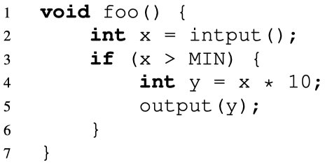
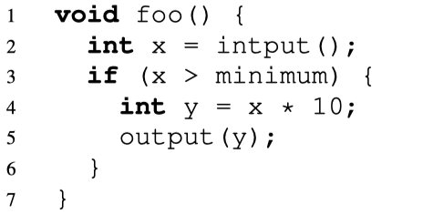
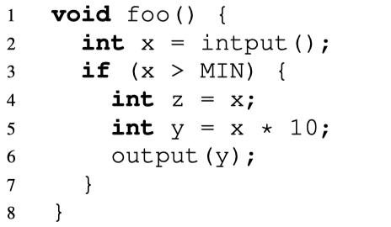
BlockScope vs. State-of-the-art Tools
Patch-based
code clone detection
ReDeBug
[SP’12]
VUDDY
[SP’17]
MVP
[Usenix’20]
VGraph
[EuroSP’20]
Language
Dependent
Hash tokenized contexts
Cannot detect Type-2
Add variable abstraction
Cannot detect Type-3
More “program analysis”
Hash-based “exact” code matching for the basic unit
This path: to generate better “hashes” (generic and more accurate)
Language
Agnostic
BlockScope
Context-based code search (to speed up)
Similarity-based code match (to cover more vulns)
Original Vuln Code
Type-2 Clone
Type-3 Clone
Our path: do not use “hash” the basic unit
but design a better way to calculate their “similarity”
Notes:
Note that there are some previous works targeting on the similar problem.
Specifically, ReDeBug was among the most representative works in this direction, and it has been widely used because of its generality and public code.
It uses the hash of several tokens for code matching.
But it cannot detect type-2 clones, where type-2 clones refers to code only with variations in identifiers, literals, and types.
Following ReDeBug, VUDDY added variable abstraction as a preprocessing and used the generated fingerprints for more scalable code clone detection.
However, it is unable to detect type-3 clones, that is code with added or deleted statements.
Similarly, MVP and VGraph conducted more “program analysis” in the form of program slicing and code property graph before similarity measurement to improve the detection accuracy.
These tools all apply a hash-based code match for the basic unit, and try to generate better hashes.
Moreover, since VUDDY, MVP, and VGraph require function abstraction and normalization, they are language denpendent.
Compared with them, BlockScope is language agnostic, which took a completely different path by proposing more suitable candidate code search for our problem and improving the code similarity measurement itself.

Slide 13
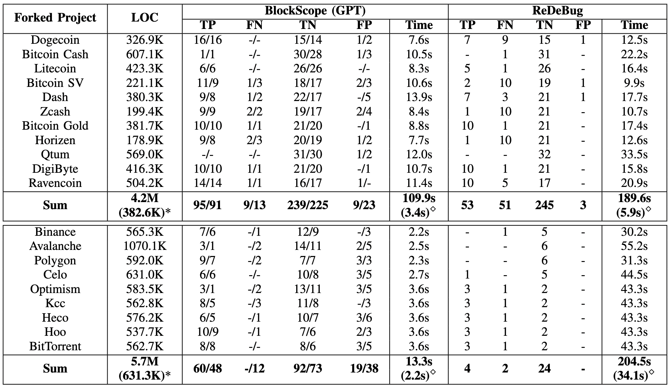
Detection Results (32 Patches from BTC & 6->19 from ETH)
Notes:
As we can see, BlockScope can detect 40+ true vulnerabilities than ReDeBug and reaches a precision and recall at both 91.8%.
Though ReDeBug has less FPs, it also has too many FNs.
This is because BlockScope adopts a context-based similarity match, rather than a hash-based exact match.
BlockScope is also faster than ReDeBug.
This is because ReDeBug’s performance is significantly effected by the project’s line of code, while BlockScope is effected by the number of security patches.

Slide 14
The Breakdown for Three Clone Types
Type-1&3 clones occupy 95.5% of all the cases.
BlockScope accuracy:
Type-1: 100%;
Type-2: 80%;
Type-3: 85.7%.
ReDeBug accuracy:
Type-1: 85.7%;
Type-2: 0%;
Type-3: 26.8%.
Notes:
We further explore why BlockScope has a much better detection effectiveness than ReDeBug by analyzing the detailed results of detecting different clone types.
We can see that type 1 and type 3 clones occupy 95% of all the cases.
BlockScope achieves promising accuracy for all three types; ReDeBug, on the other hand, only detects 26% type 3 clones and fails to detect any type 2 clone.

Slide 15
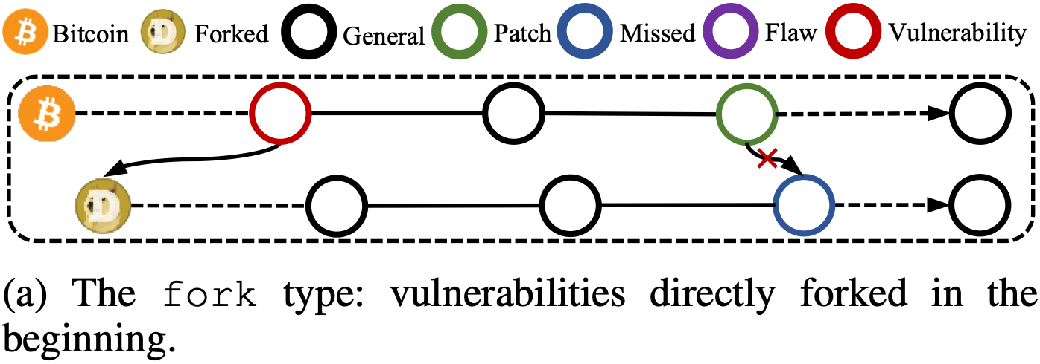
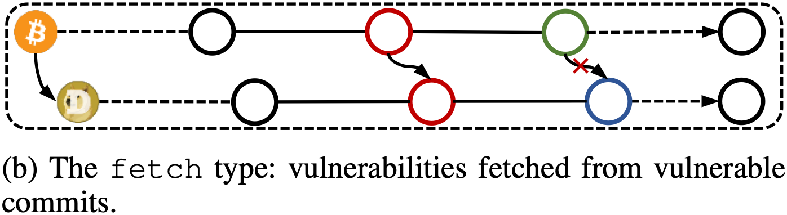
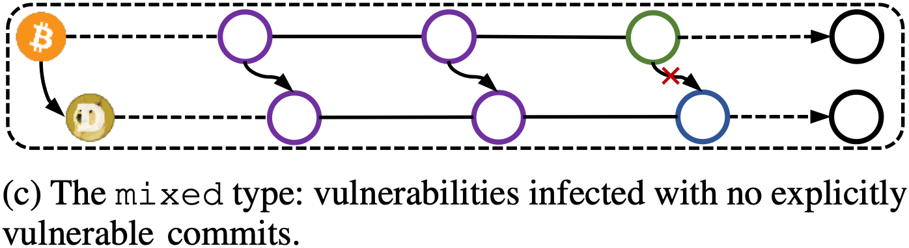
Investigation of Propagated Vulnerabilities
41 cases, e.g., CVE-2022-29177, CVE-2021-41173.
25 cases, e.g., CVE-2021-3401, CVE-2020-26265, CVE-2020-26264, CVE-2020-26260.
44 cases, e.g., Bitcoin PR#16512.
Notes:
To reveal how a vulnerability is propagated, we manually check all the 110 vulnerabilities, and categorize them into three types.
The first type is the fork type, which means the vulnerability is forked in the beginning when the projects initialized.
We have 41 cases of this type.
The second type is the fetch type, indicating the vulnerability is introduced to the forked project by fetching vulnerable commits from the source project.
There exists 25 cases of this type in our investigation.
While the third type is the mixed type, that the vulnerability is caused several commits.
We have 44 cases of this type.

Slide 16
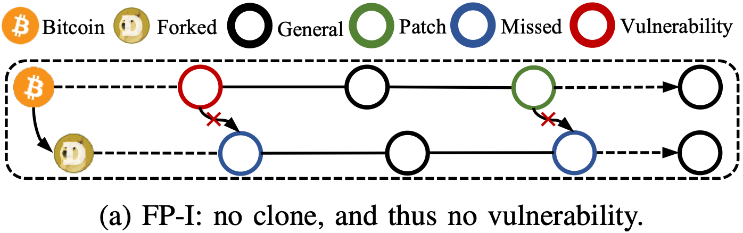
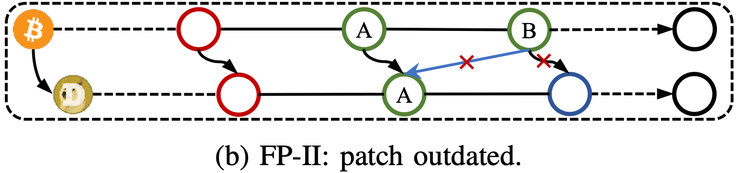
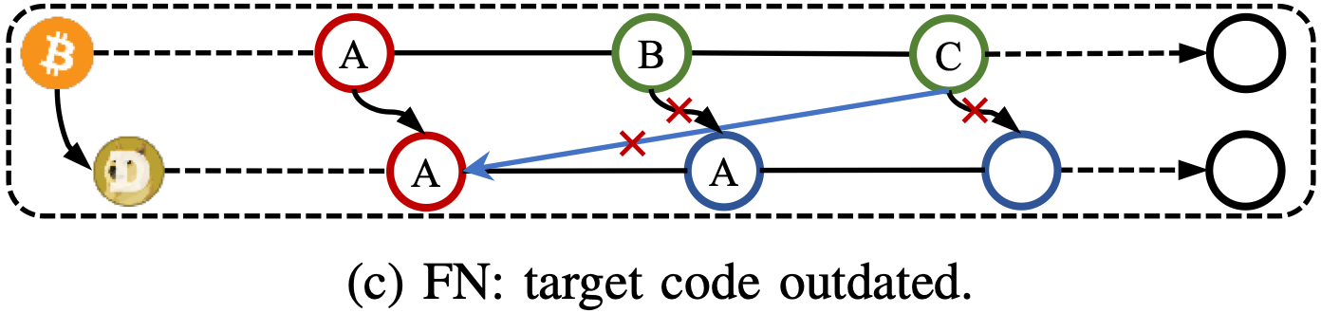
Our Limitation
FP-I: 7 cases, e.g., CVE-2018-17145, CVE-2019-15947, Bitcoin PR#12561, Bitcoin PR#14249.
FP-II: 2 cases, e.g., Bitcoin PR#12561, Bitcoin PR#13808.
FN: 9 cases, e.g., Bitcoin PR#10345, Bitcoin PR#11568, Bitcoin PR#13907.
Notes:
BlockScope also occurred 18 failed cases.
The first type FP-1 that caused 7 false positives.
The forked project sometimes keeps its outdated code and does not clone the vulnerable commit. As a result, it has no need to fetch the patch commit either.
Since BlockScope detects the vulnerable clone based on the similarity measurement with one specific patch, it is possible that it gives false alarming if the vulnerable code could be avoided in other ways.
FP-2 type indicates an outdated patch means that the forked projects had fetched a patch commit but neglected its further update.
For example, the vulnerability is fixed by commit A in the forked project, but we use the latest commit B to test.
The last type caused 9 false negatives. when the target code where the patch applies to is outdated. In this case, the forked project indeed fetch the vulnerable commit, but the source projects use two commits to fix the vulnerability, the forked project did not apply any of them. We use the latest commit c to test and encounter the failure.

Slide 17
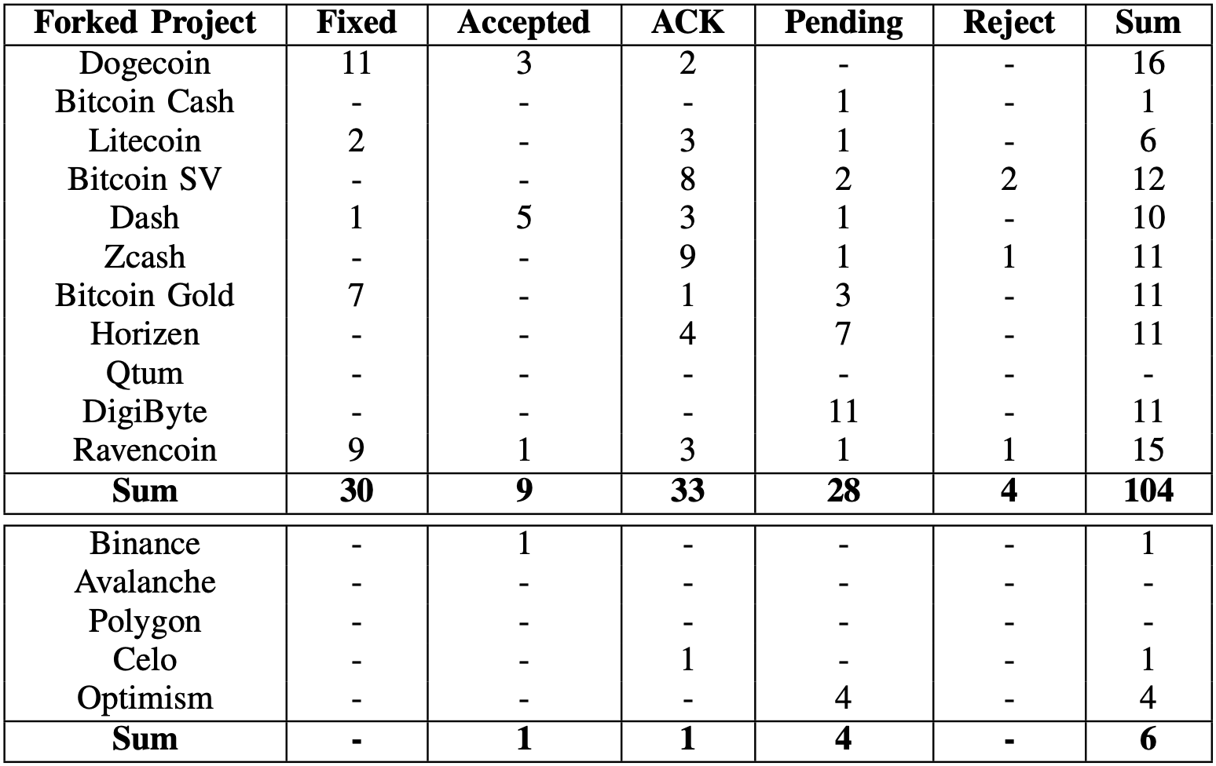
Vulnerability Report Response
Reported 110 vulnerabilities (101 TP + 9 FN);
74 positive response;
CVE-2021-37491 of Dogecoin & CVE-2021-37492 of Ravencoin
1 bug bounty from Binance;
Dogecoin, Ravencoin, Dash, Bitcoin Gold, Litecoin, and Binance are the most active ones;
Bitcoin Cash, DigiByte, and Optimism did not respond to any of our reports.
Notes:
As an ethical research and one contribution of this paper, we have spent significant efforts reporting all the 110 discovered vulnerabilities, including 9 FNs.
We received 74 positive responses, 2 CVEs for dogecoin and ravencoin, and one bug bounty from binance.
6 projects, including dogecoin, ravencoin, and dash, are the most active ones.
3 projects, Bitcoin Cash, DigiByte, and Optimism, did not respond to any of our reports.

Slide 18
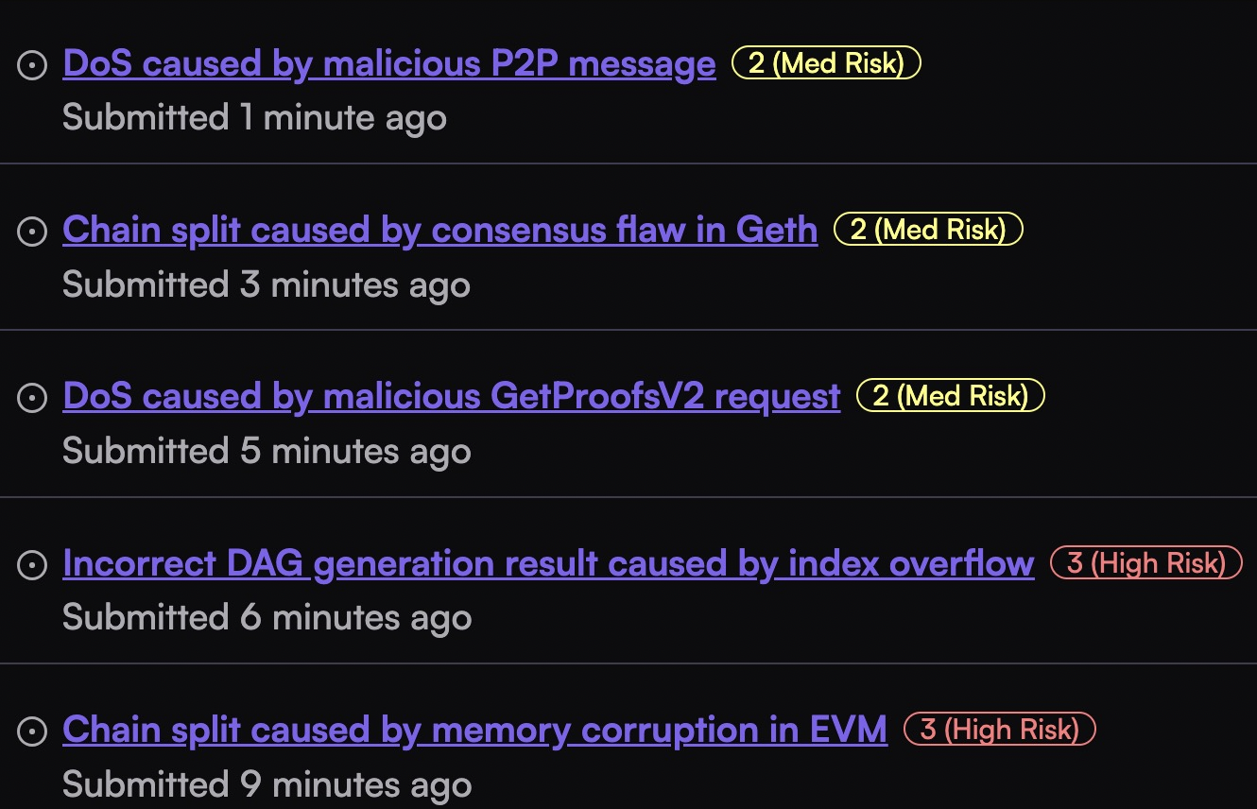
Our vulnerability discovery in BSC/Optimism/Base/Mantle

Slide 19
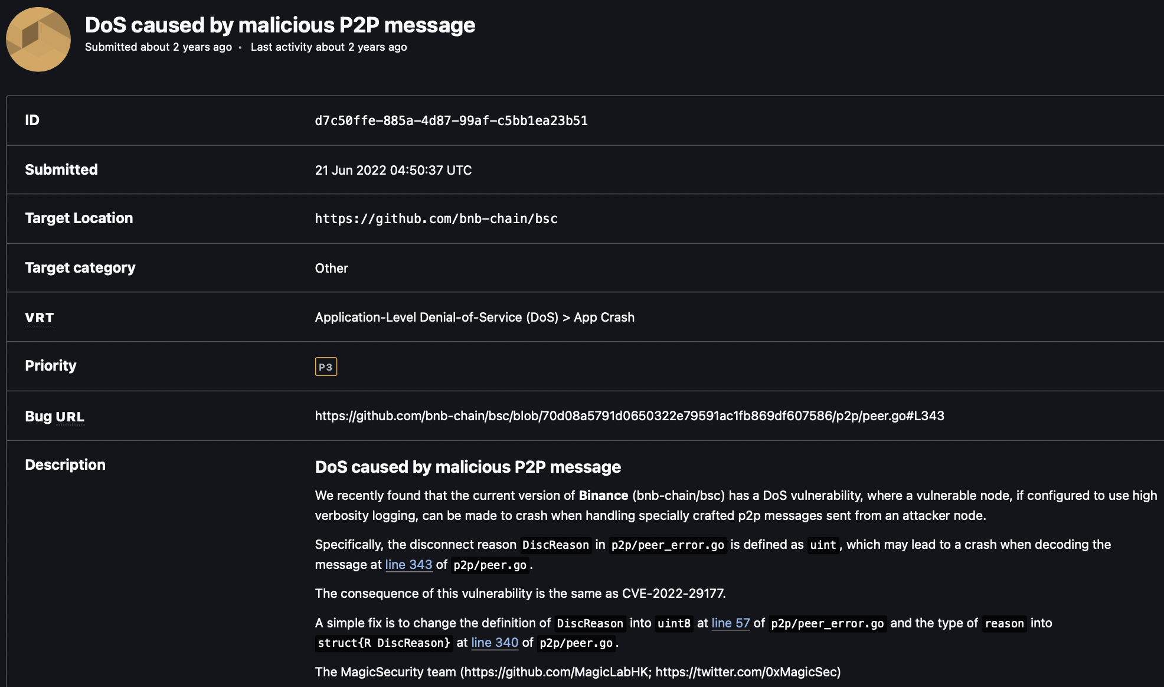
CVE-2022-29177 in Binance BSC

Slide 20
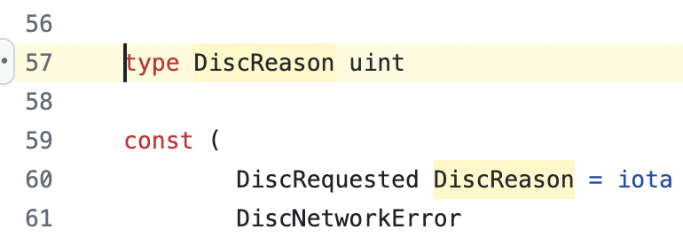
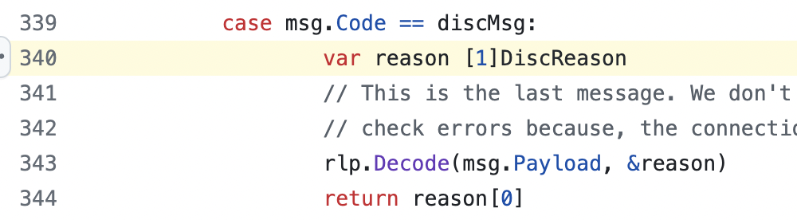
CVE-2022-29177 in Binance BSC
A vulnerable node, if configured to use high verbosity logging, can be made to crash when handling specially crafted p2p messages sent from an attacker node.
The disconnect reason `DiscReason` in `p2p/peer_error.go` is defined as `uint`, which may lead to a crash when decoding the message at line 343 of `p2p/peer.go`.
A fix is to change the definition of `DiscReason` into `uint8` at line 57 of `p2p/peer_error.go` and the type of `reason` into `struct{R DiscReason}` at line 340 of `p2p/peer.go`.

Slide 21
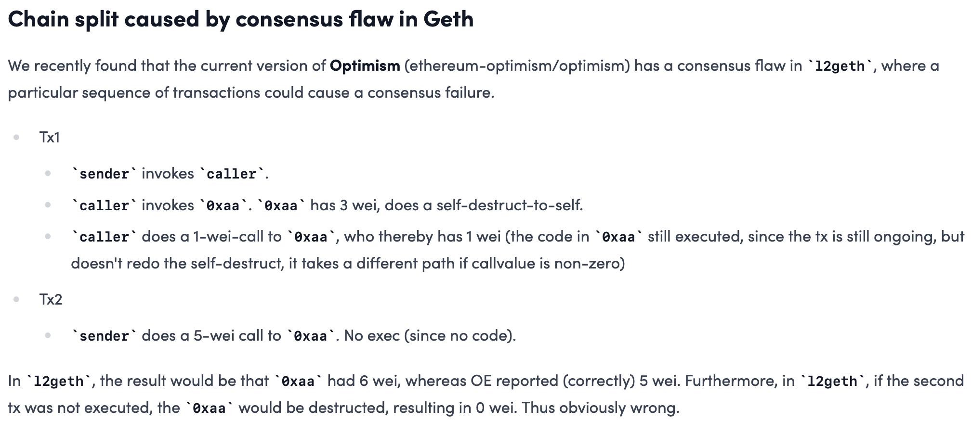
CVE-2020-26265 in Optimism

Slide 22
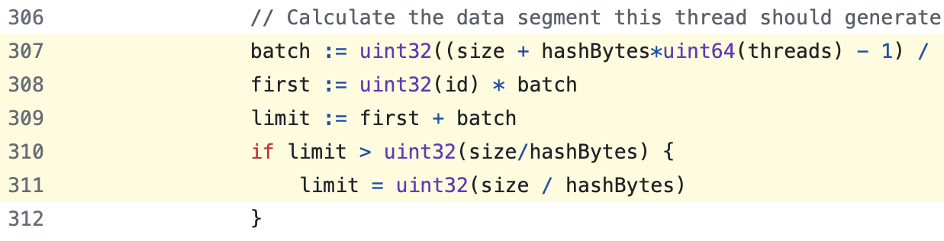
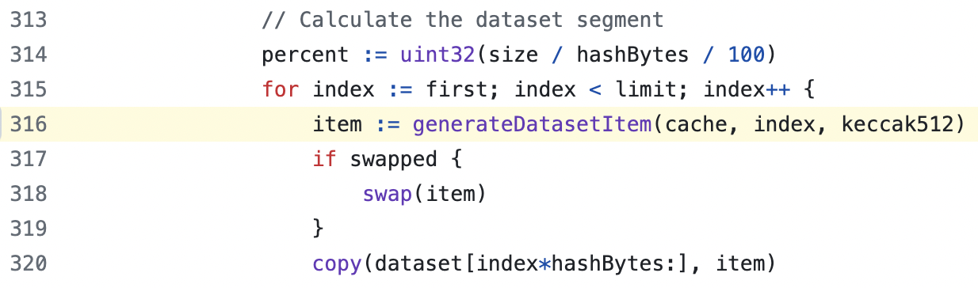
CVE-2020-26265 in Optimism
The problem lies in line 307-311 and line 316 of `l2geth/consensus/ethash/algorithm.go`. Substitute the `uint32` into `uint64` could fix the issue.

Slide 23
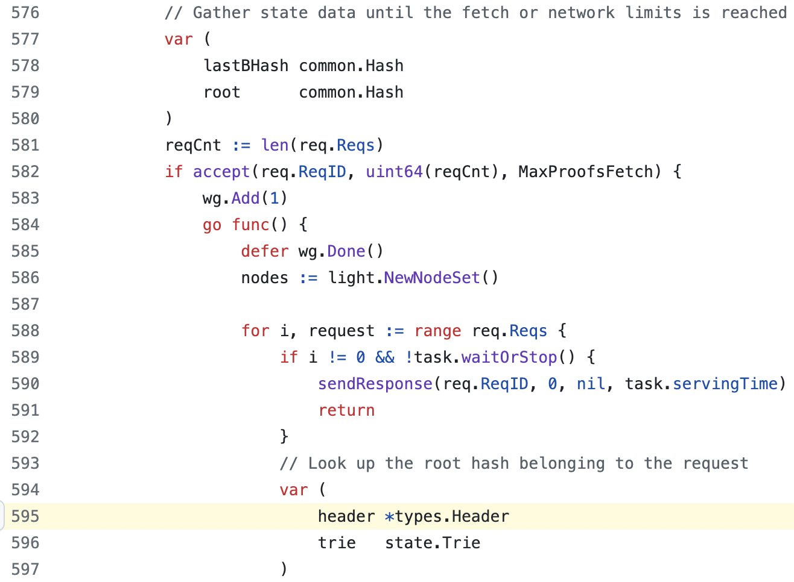
CVE-2020-26264 in Base
It had a DoS vulnerability in LES, which can make a LES server crash via a malicious `GetProofsV2` request from a connected LES client.
The problem lies in line 595 of `l2geth/les/server_handler.go`, where the `header` could potentially be `nil` and leads to a panic.
A simple solution is to move line 595 after line 579.

Slide 24
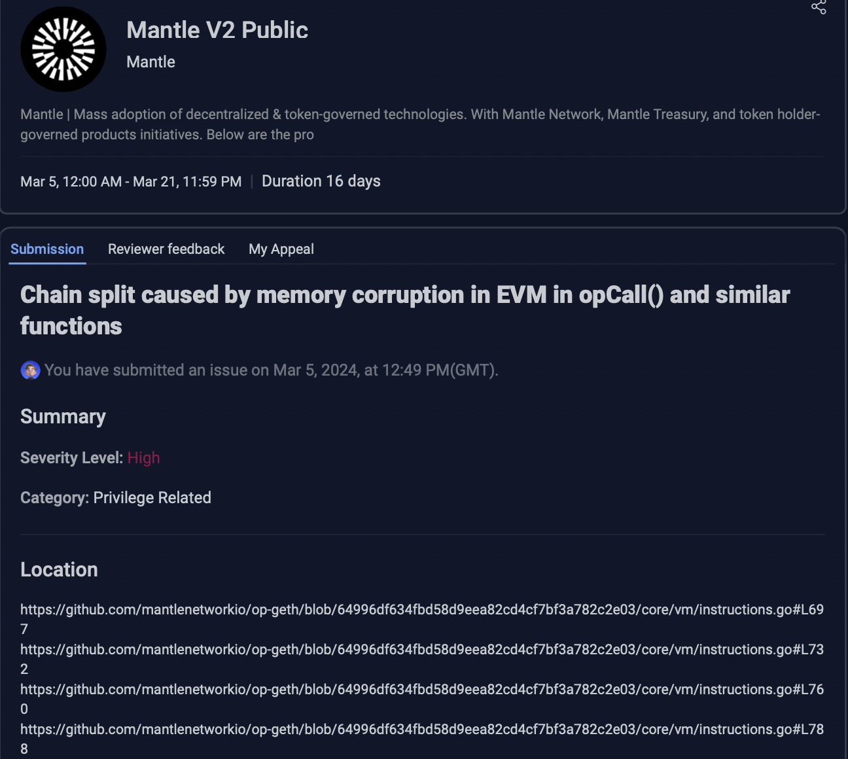
CVE-2021-39137 in Mantle
It has a memory corruption vulnerability in EVM, which can cause a consensus error
Vulnerable nodes obtain a different `stateRoot` when processing a maliciously crafted transaction. This, in turn, would lead to the chain being split into two forks.
The problem lies in four functions, i.e., `opCall`, `opCallCode`, `opDelegateCall`, and `opStaticCall` of `core/vm/instructions.go`.
A simple solution is to use `common.CopyBytes` to copy `ret` safely before use, e.g., add `ret = common.CopyBytes(ret)` before line 698.

Slide 25
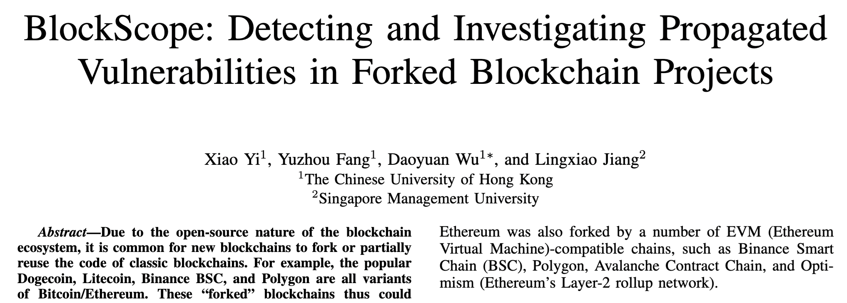
Acknowledgement
This work is made possible with my former PhD student, Xiao Yi (now a Researcher at Huawei HKRC), and Research Assistant, Yuzhou Fang (now a PhD student at USC).
BlockScope is now open-source at https://github.com/VPRLab/BlockScope.
Whitepaper: https://www.ndss-symposium.org/ndss-paper/blockscope.

Slide 26
Takeaway
introduced our recent efforts to discover how Ethereum’s CVE vulnerabilities could propagate from Ethereum to BSC/Optimism/Base/Mantle.
Developed BlockScope (https://github.com/VPRLab/BlockScope), a novel search-based patch vs. code similarity analysis tool for discovering 100+ vulnerabilities in top blockchains.
Analyzed vulnerabilities in BSC/Optimism/Base/Mantle (1 for BSC, 4 for Optimism, and 5 for Base/Mantle).

Slide 27
Thank you! Q&A ☺ Contact: @MagkDao

